Slide 1

CS 4360: CubeSat Presentation
Logan St. Cyr
Justin Figueredo
Victoria Crowley

Slide 2
Table of contents
Current Sprint
CAD Design, GitHub organization, code review, document finalization
All Previous Sprints
Major Takeaways
Team Size
Organization
Trello and Toggl Tracking Tools
Minimum Viable Product
Stretch Goals

Slide 3
Current Sprint: It’s the Final Countdown
Chassis build
Some internal work with CAD/SolidWorks was done regarding the payload, and how to best fit internal components
Build day was cancelled, plasma cutter was not available, welder had COVID
Documentation
Revised internal documentation to reflect current hardware, software integrations, and additional components
Interface Control Documents were not completed
Software
Refactored code for the use of a single configuration model
Outreach
Met with Dennis from AES to share developed code, discuss next steps for their team, possible recruitment from the CS department

Slide 4
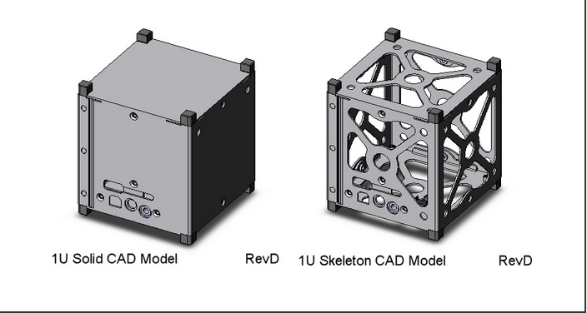
Current Sprint: CubeSat CAD Diagram

Slide 5
Sprints
7 Sep.
Mission planning phase, project outlined, scope of project decided, stretch goals and minimum viable product decided
14 Sep.
Ground System setup with SatNOGS software, receive a signal from a satellite
21 Sep.
Ground System and payload integration with ham radios, troubleshooting, and testing
5 Oct.
Balloon communication system integration with ham radio, chassis and other component planning
19 Oct.
Construction of chassis for balloon system and testing for communication between ground system and transmission system
2 Nov.
Troubleshooting signal relay, GPS and other sensor integration into chassis. Launch of system and recovery, analysis
Recalculate Link budget, plan Aluminum chassis and other possible sensors
30 Nov.
Integration of additional sensors (team member departed), continued troubleshooting of data transmission
7 Dec.
Cleanup GitHub, reconfigure the architecture for Raspberry pi and radios, upload all relevant mission data
16 Nov.

Slide 6
Major takeaways – Team Size
Small team benefits
Our team members all relied on one another to accomplish the necessary taskings
With this reliance upon one another, each team member took personal responsibility for each of their stories and did their best to accomplish them
Each team member felt comfortable with the assigned workload, and no one felt as though they were bearing the brunt of the work
Communication was not as great of a challenge
Small team challenges
When the team sized dropped, we were unable to complete some of the major taskings we had wanted to (solar panel integration, power management system)
We only had a small pool of knowledge to draw from, which meant much of the time was dedicated to research and testing as opposed to building and trying to meet stretch goals

Slide 7
Major Takeaways - Organization
Tools like Toggl Track, and Trello provide a great way to manage stories, hours, and how best to share the taskings
Delegating work based upon interest allows the opportunity for subject matter experts to operate in areas in which they are the most proficient and comfortable, however it makes it difficult for other team members to grow their knowledge base outside of their interests
Having a hard deadline pushed our team to accomplish the goal of launching a payload, and that pressure was crucial to our success

Slide 8
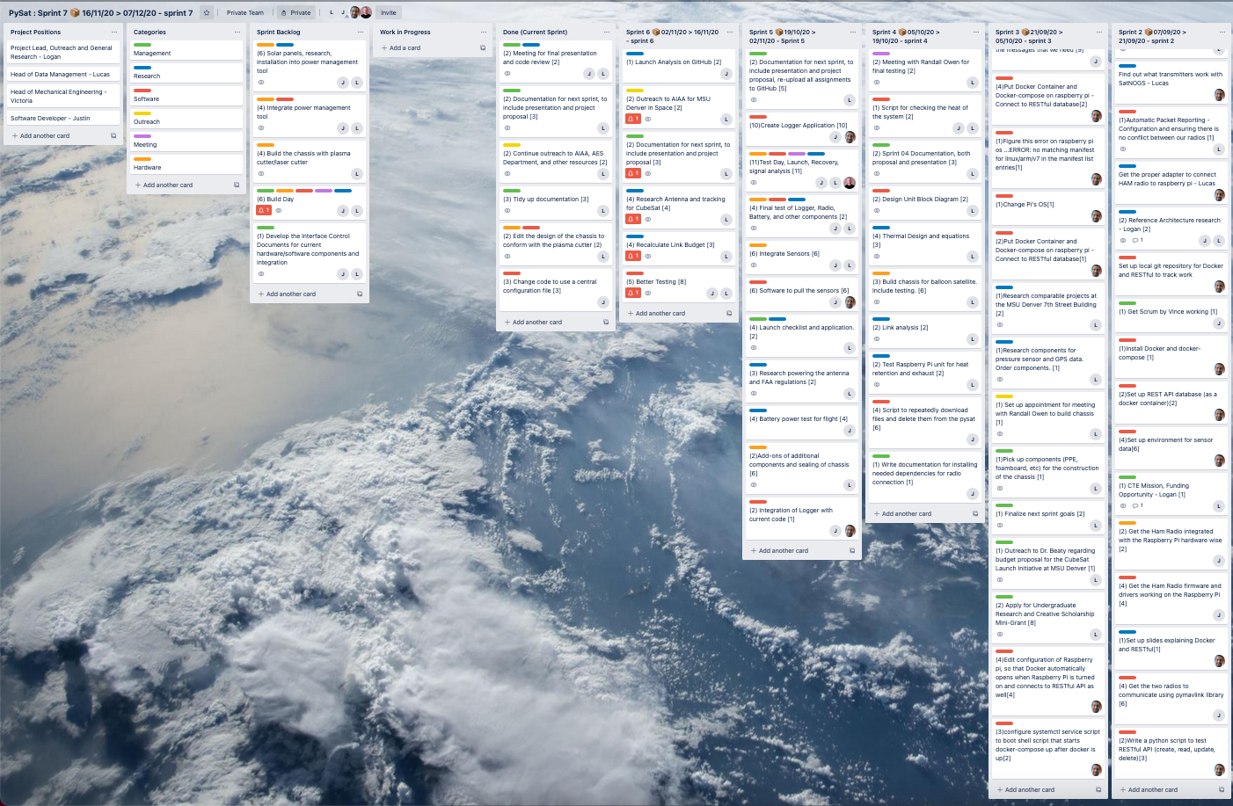
Trell-oh my goodness
Drop off in stories when team size decreased and when research not as relevant
Documentation and management became a high priority as the project reached the end of the development
Overall the team met our minimum viable product
Completed 75 stories

Slide 9
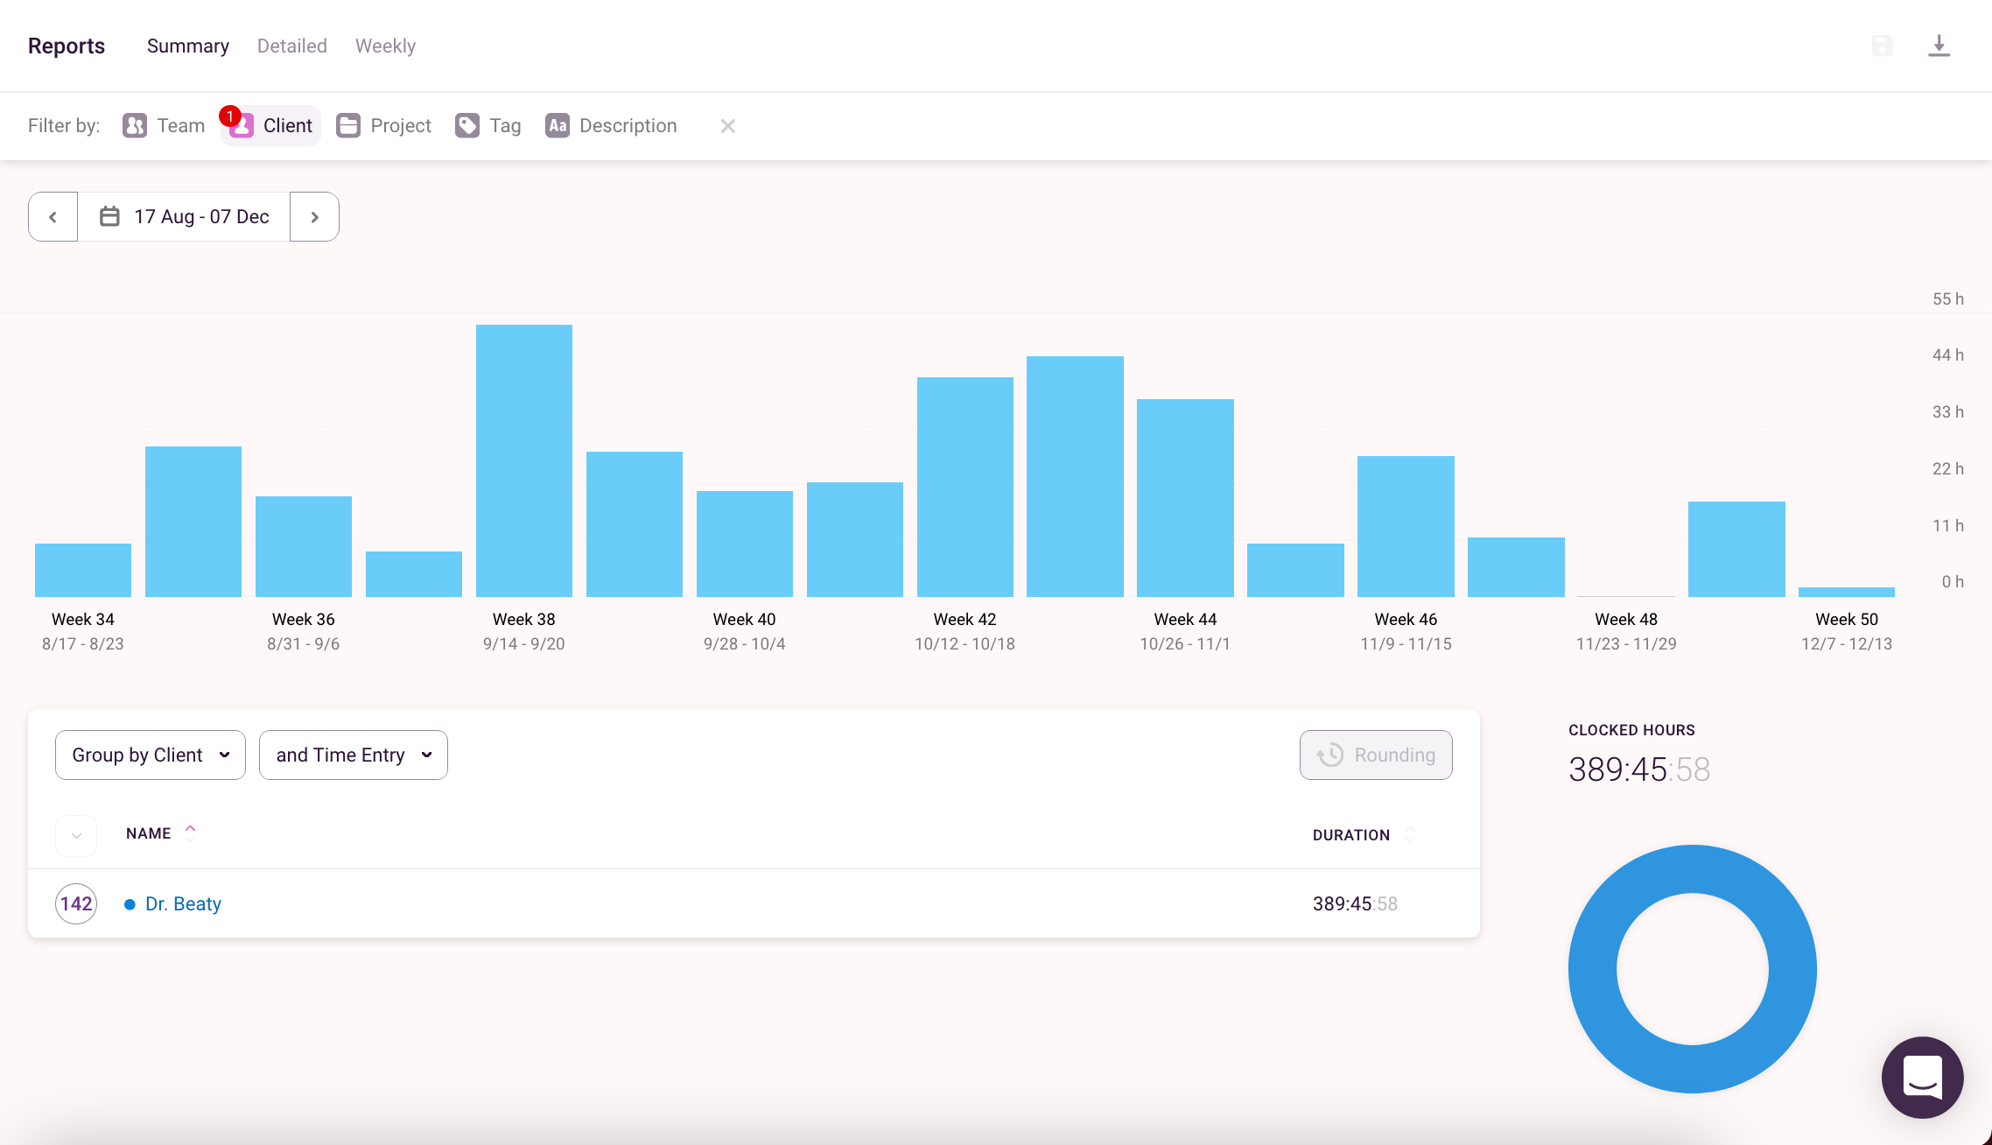
Toggl Track
Over 390 hours worked total
Final weeks included the least amount of logged hours
This is due to COVID, and the changing of the overall scope of the project
Weeks before the launch included approximately 55 hours of work split between the team members
Week of the launch included over 33 hours of work for launch, recovery, and data analysis

Slide 10
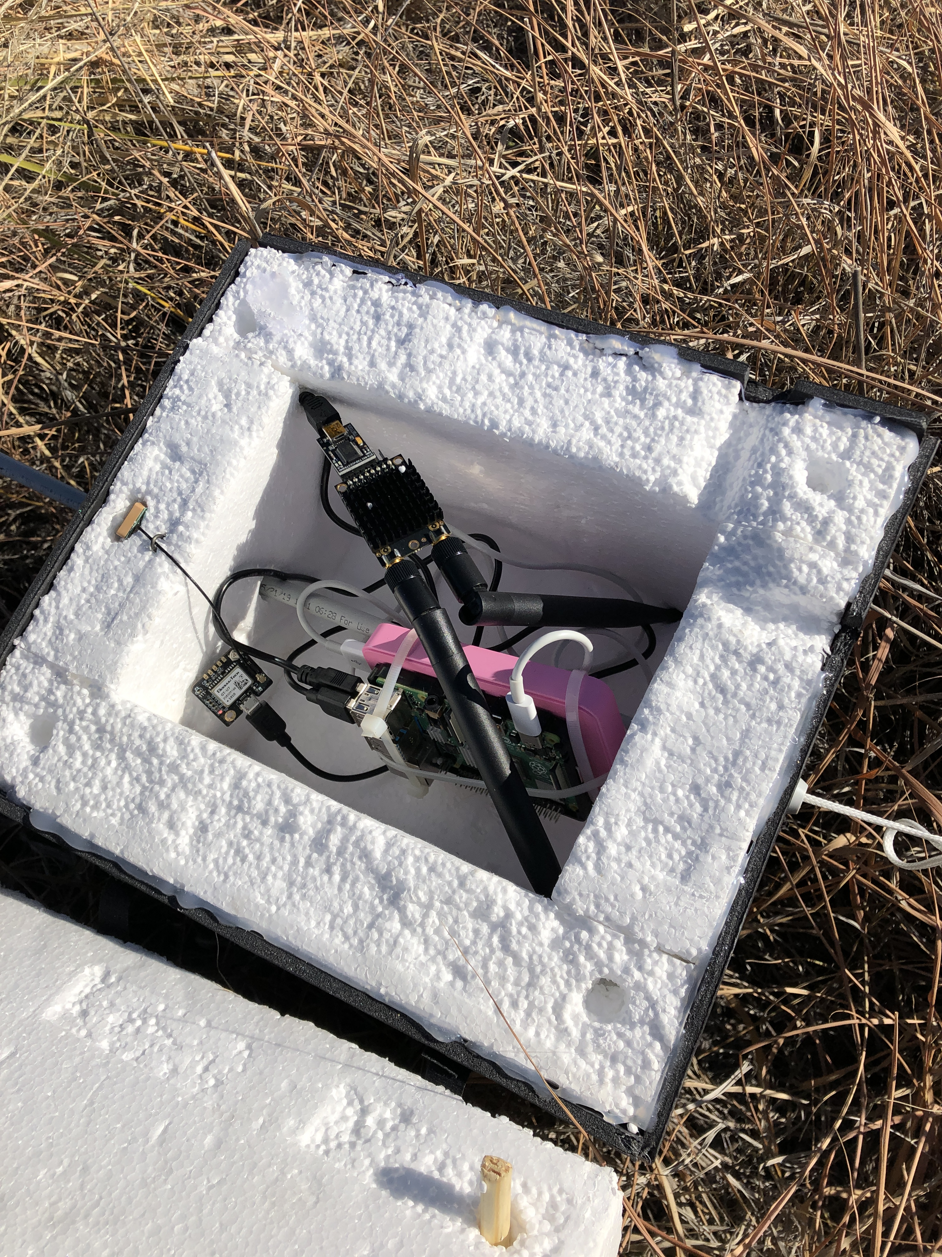
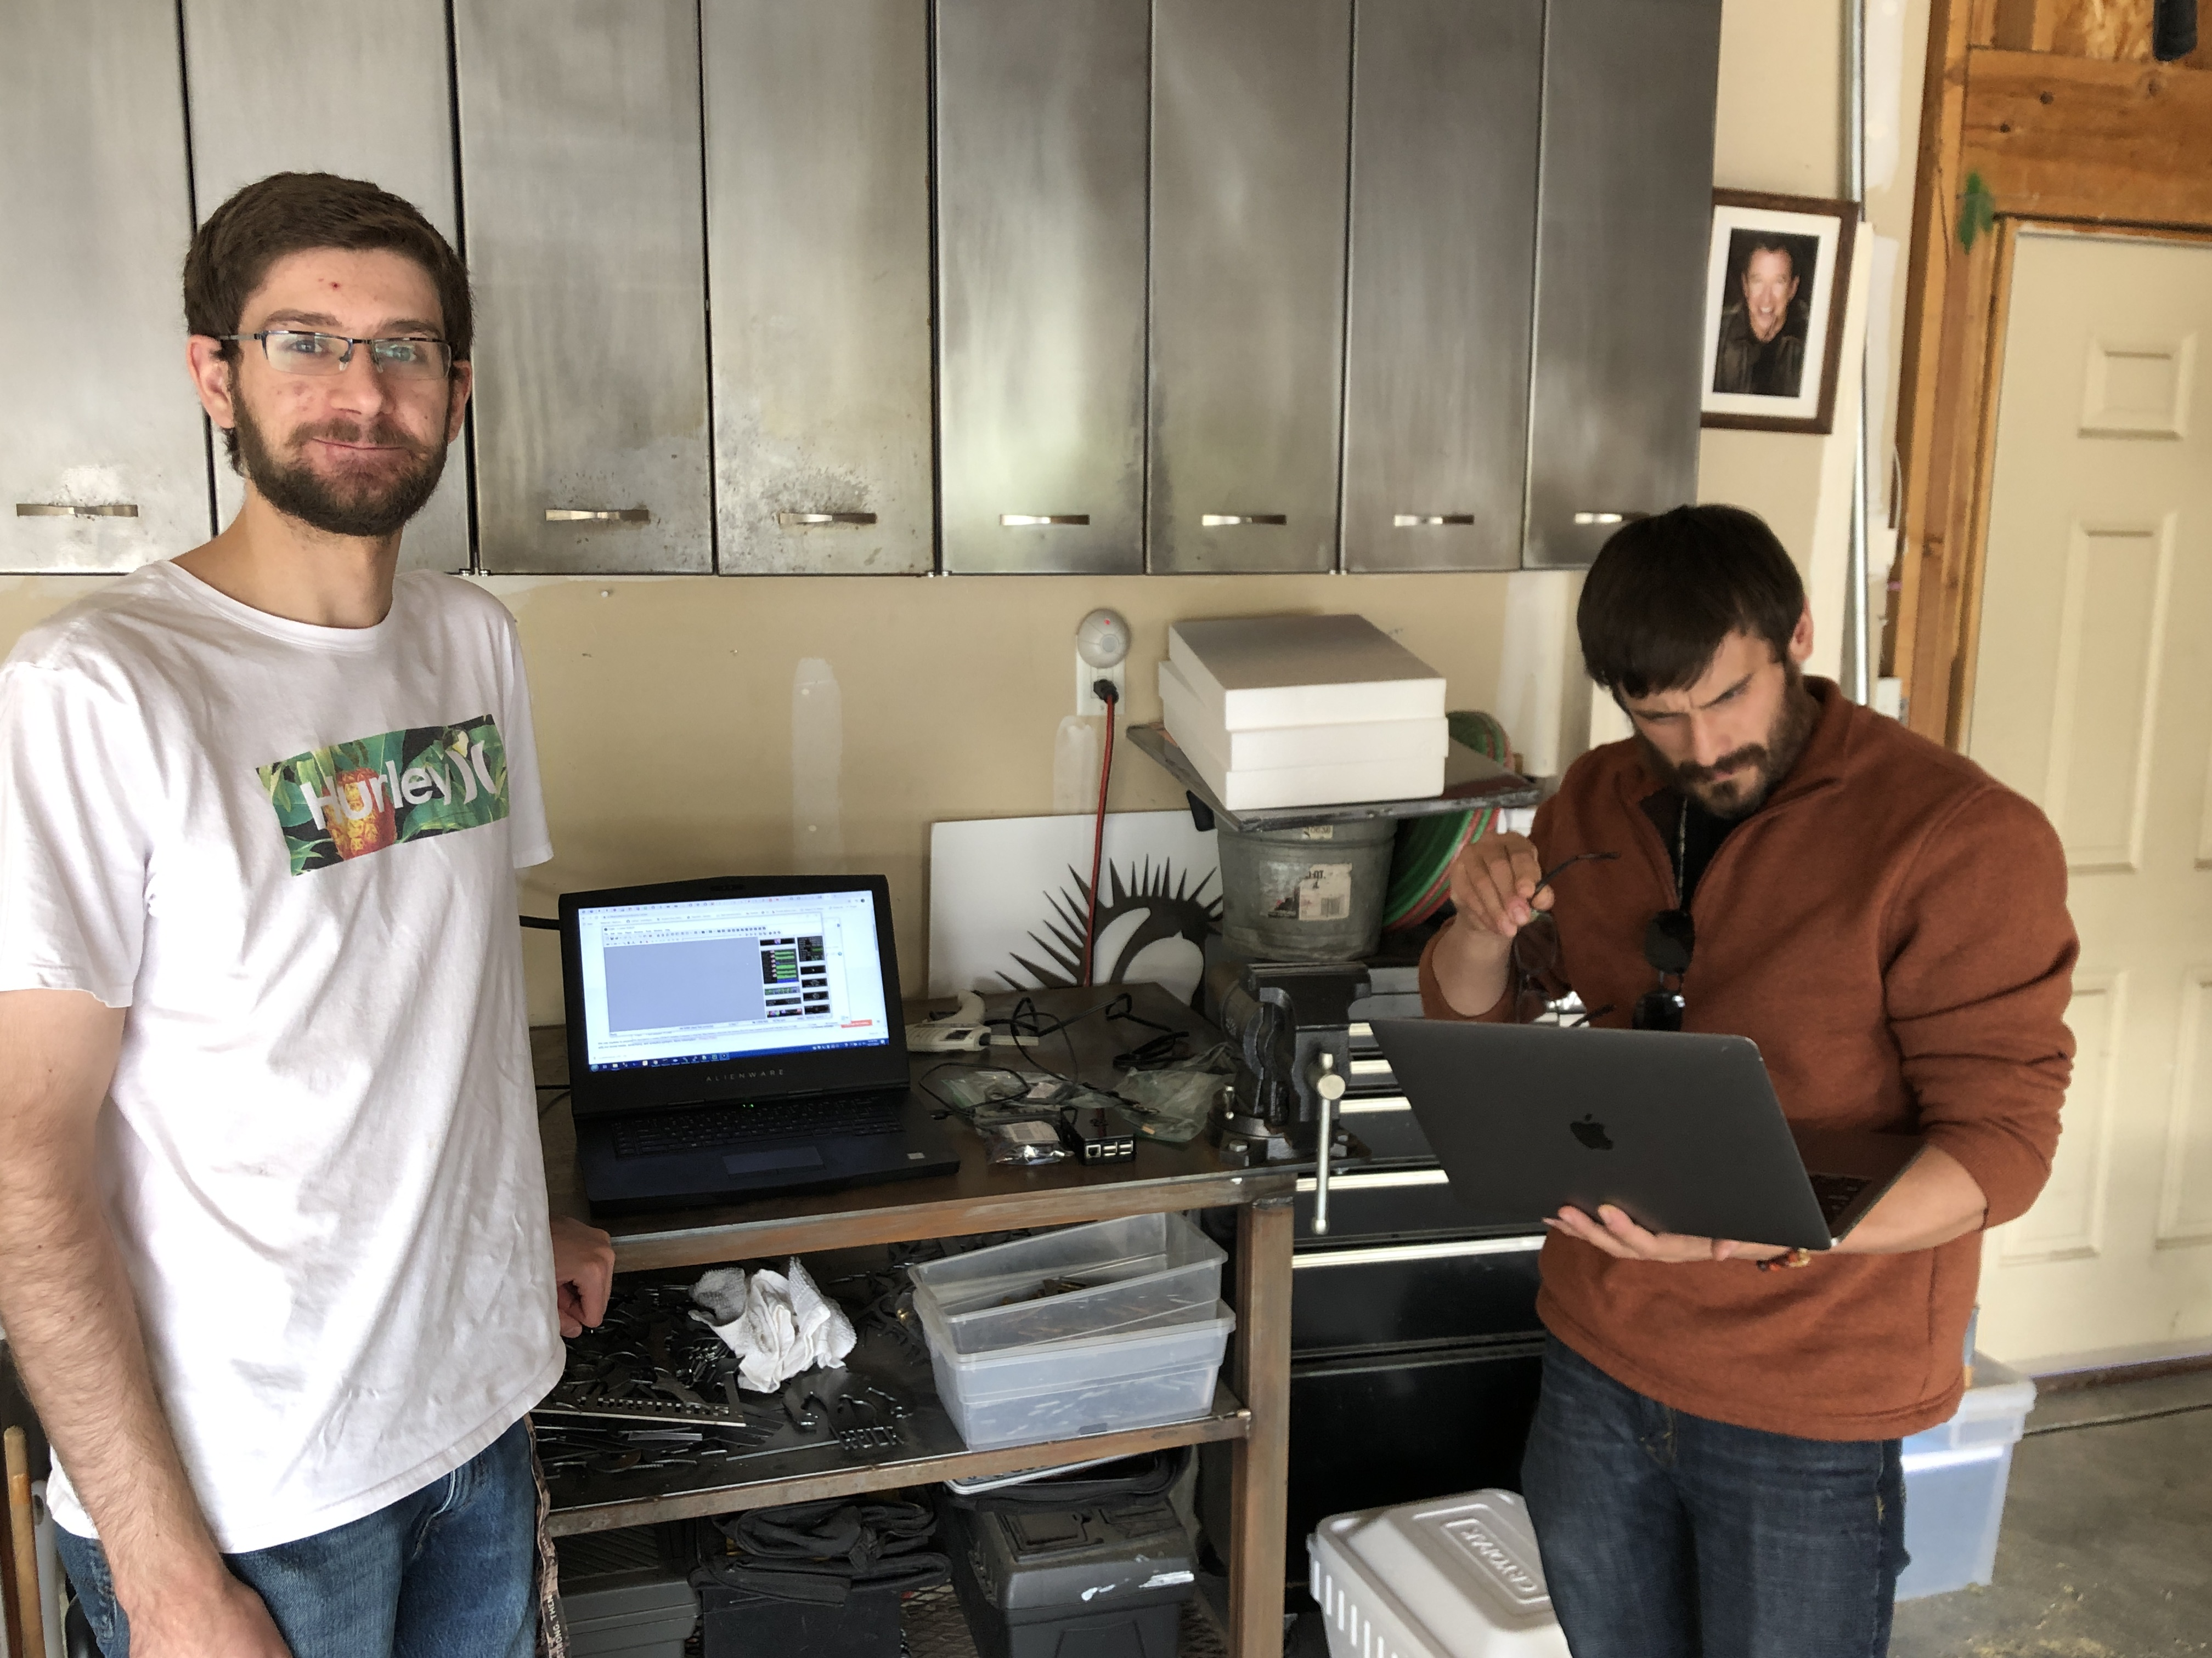
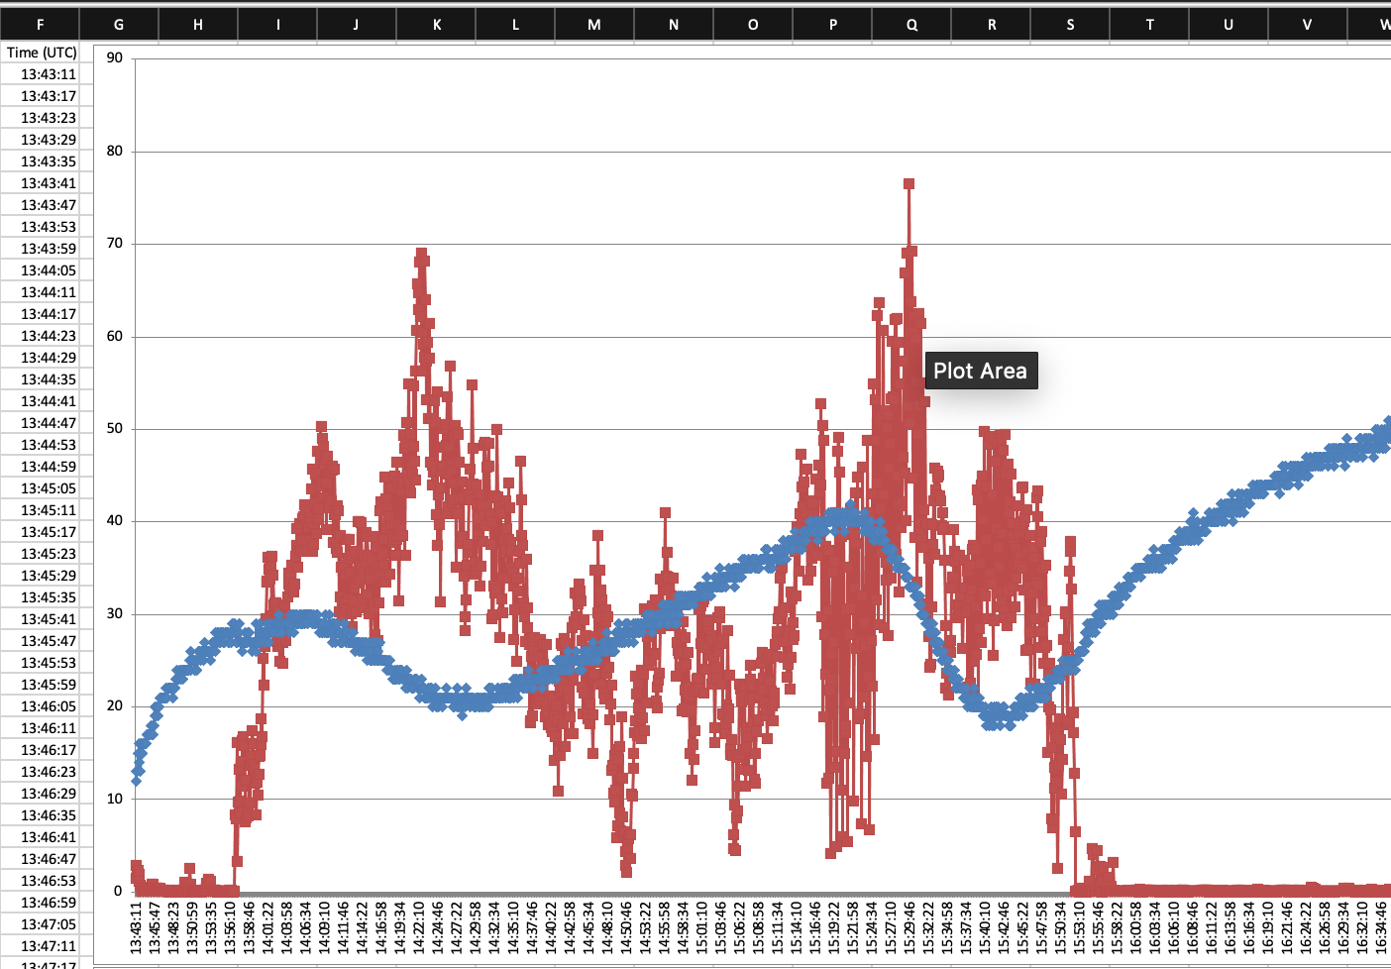
Minimum Viable Product
Gathered data that demonstrated our prototype CubeSat would operate in near space
Hardware requirements for the ground station antenna and the payload need to be upgraded to ensure the transmission of data is secure and consistent
Financial constraints made acquiring appropriate hardware for transmission a major roadblock
In 16 weeks our team developed the infrastructure for MSU Denver to continue into rapid mission prototyping

Slide 11
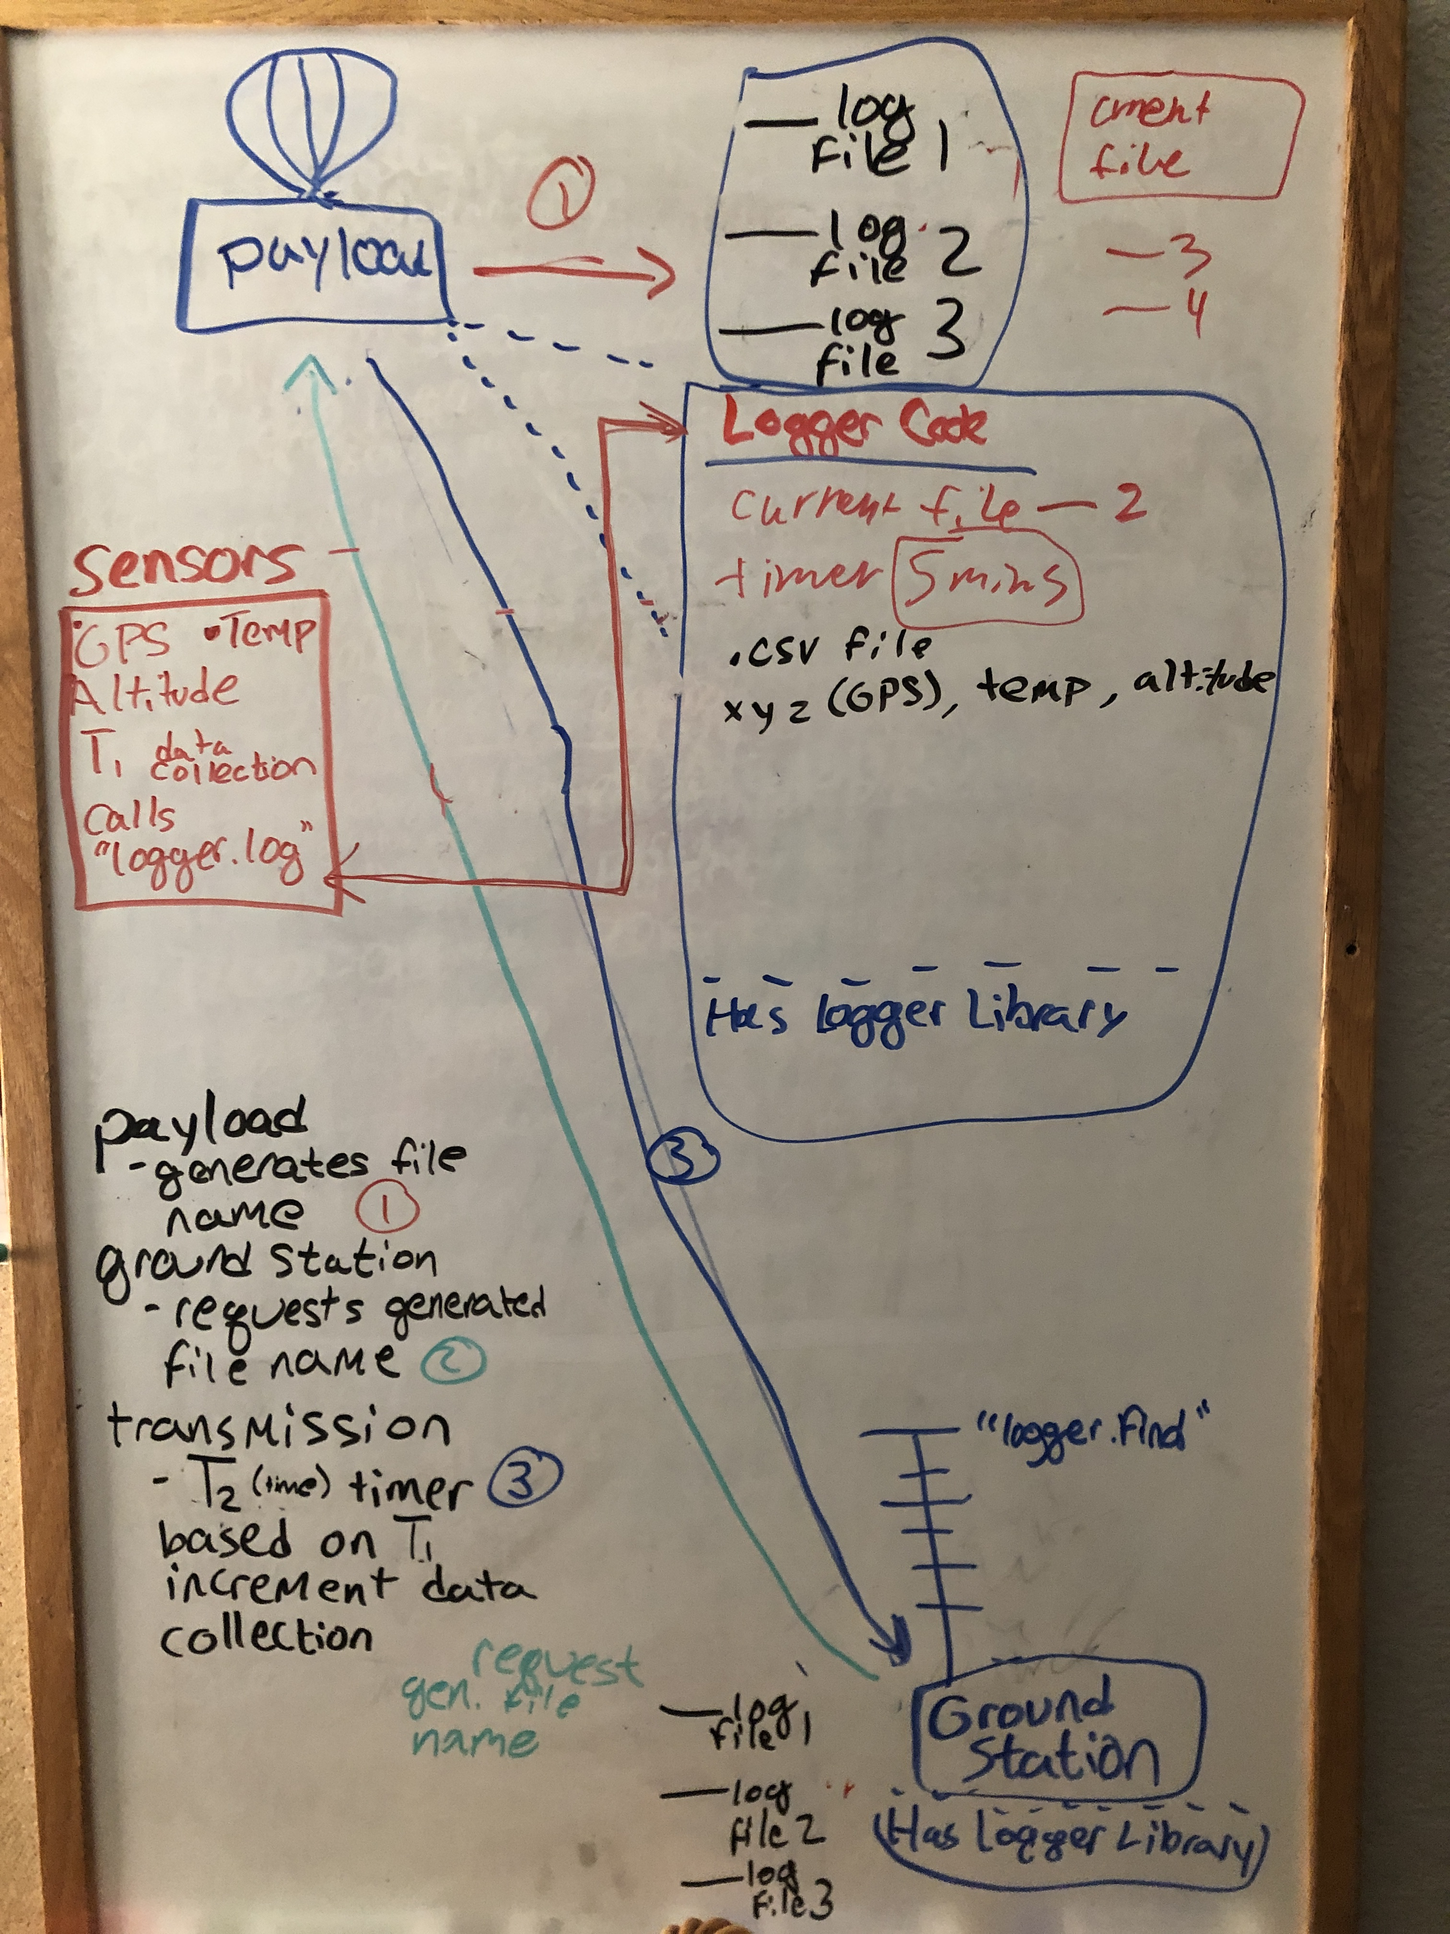
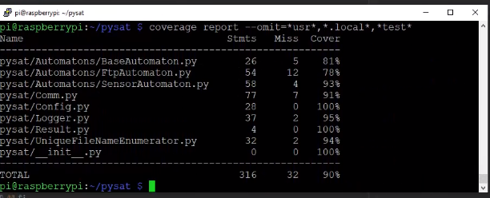
Software
Logger:
Polls sensors on the CubeSat then writes data to csv
File Downloader:
Downloads files from the CubeSat to ground station
Uses Library for the radios that have an FTP interface
Unique File Name Creator:
One shared component to enable operation
Ensures that data does not get lost due to file name collisions
Ensures that the ground station can request next file by name instead of having to ask what files are available

Slide 12
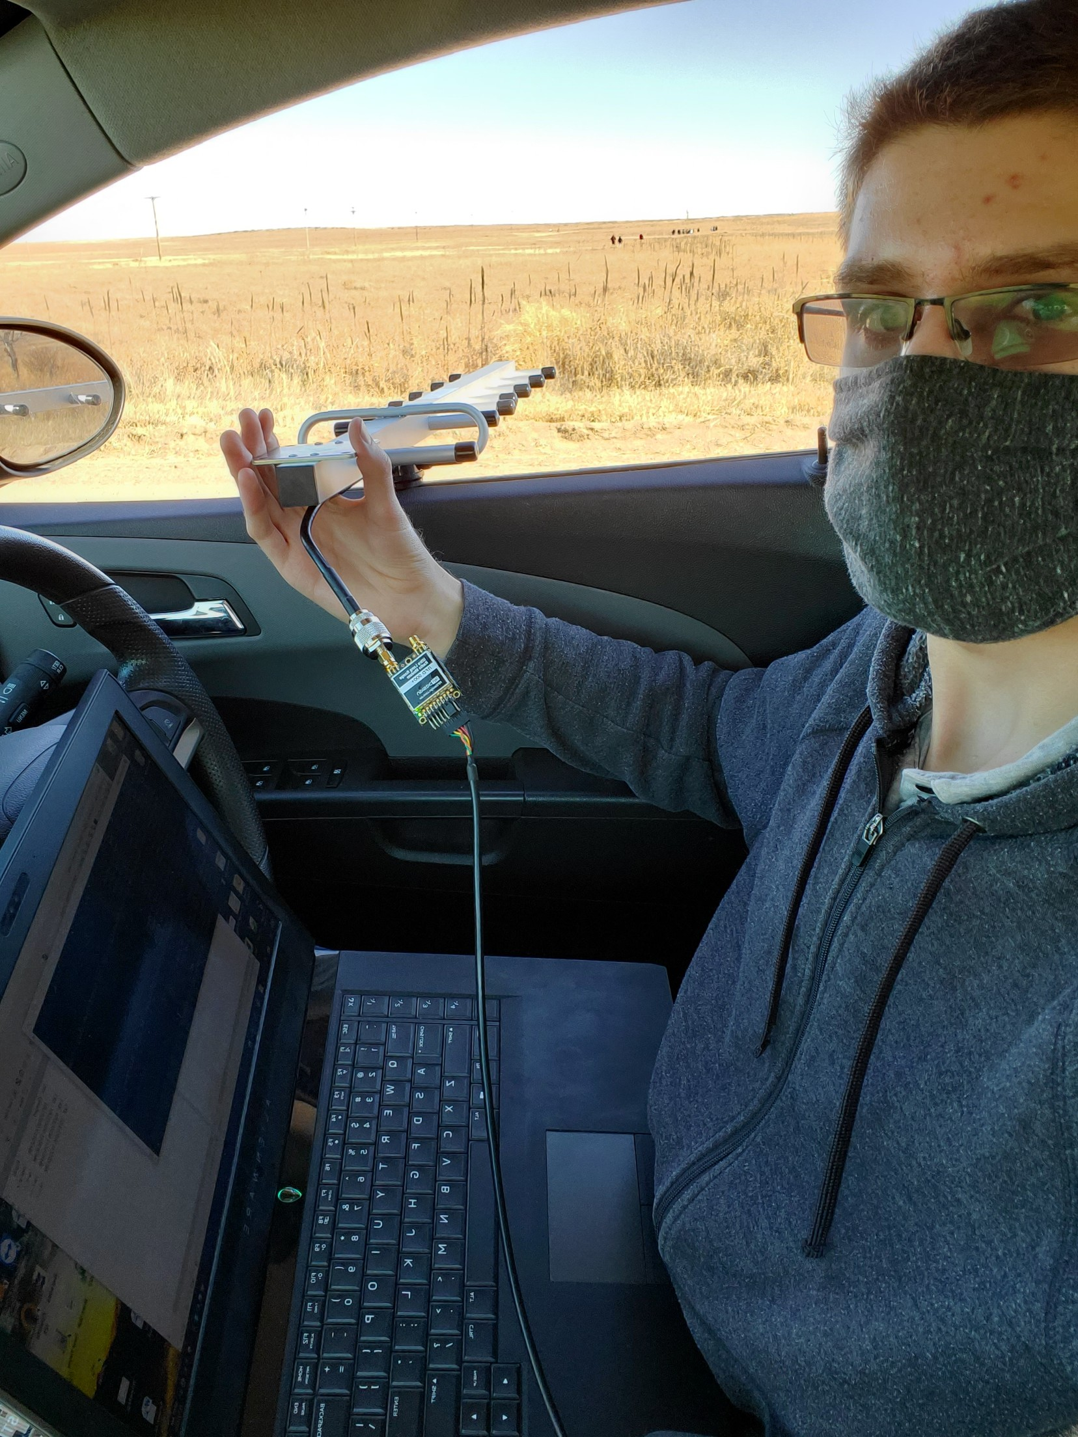
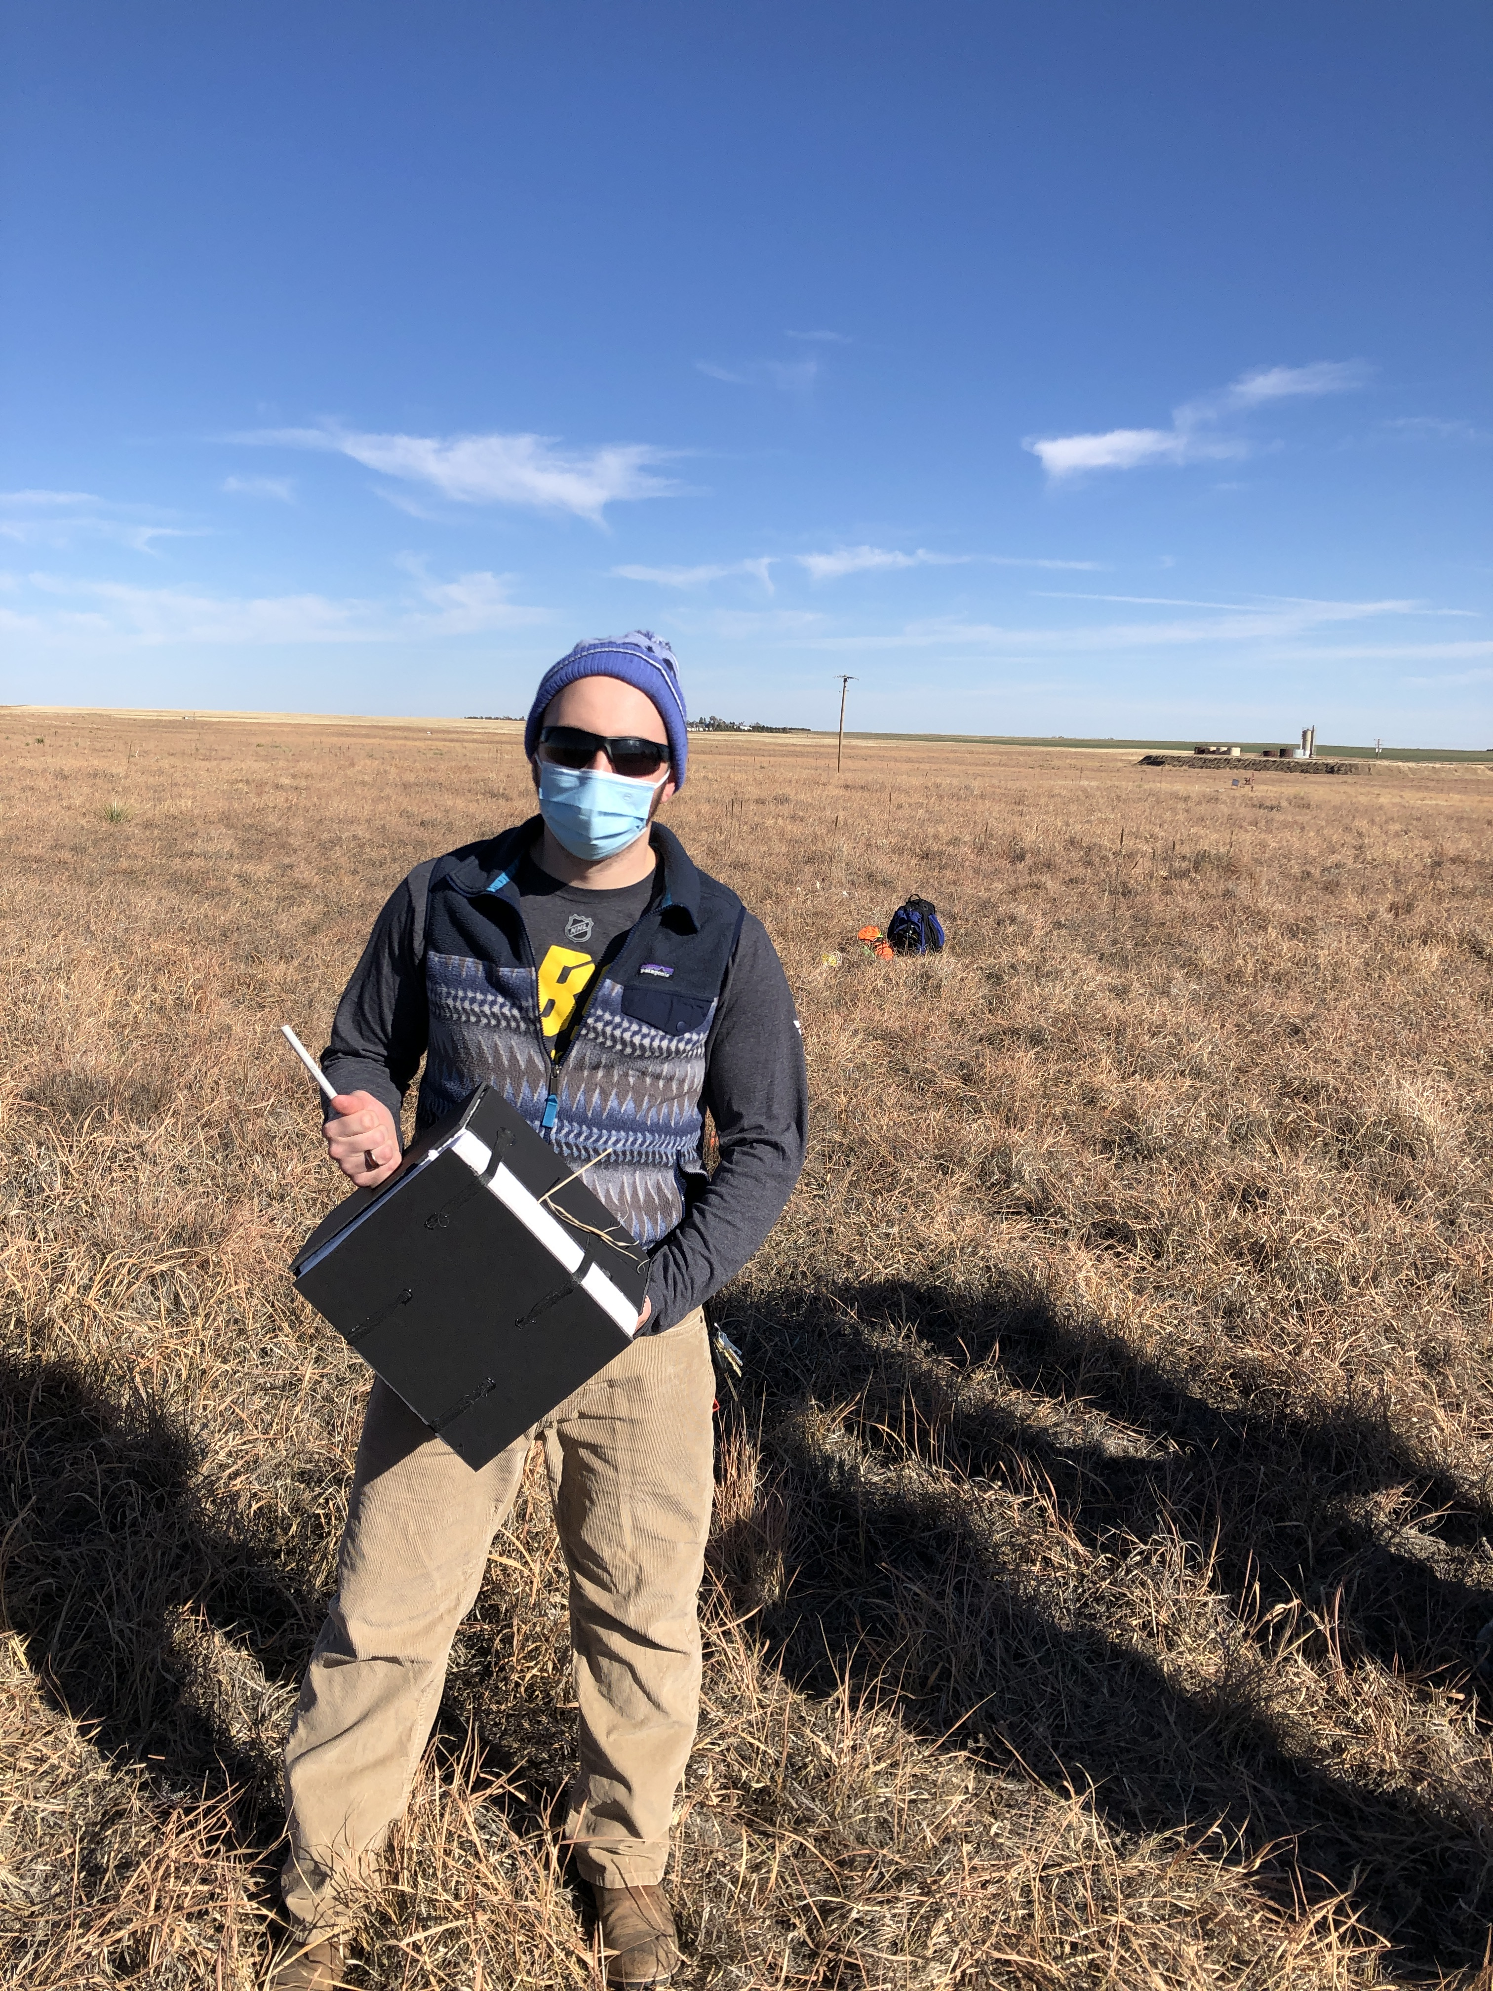
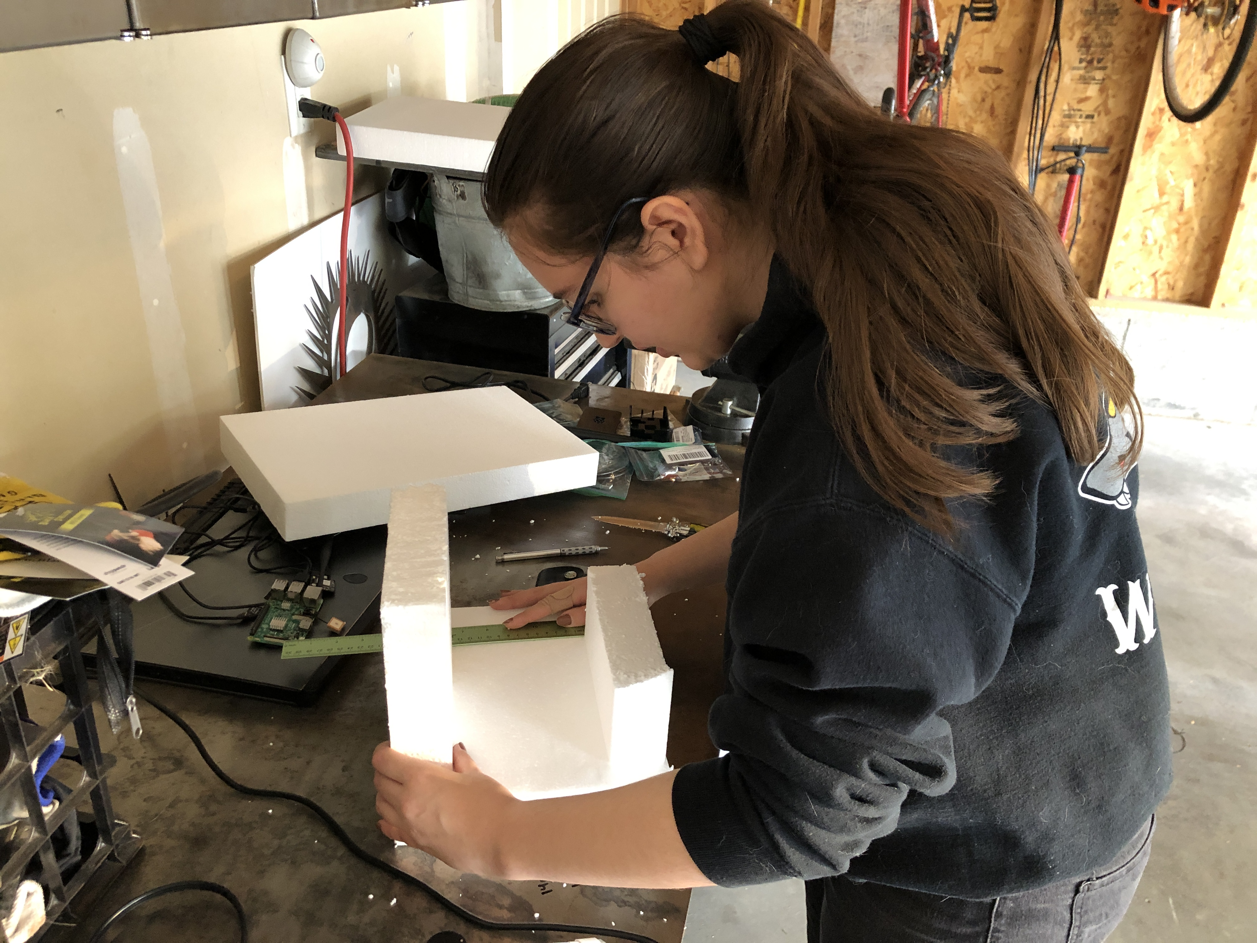
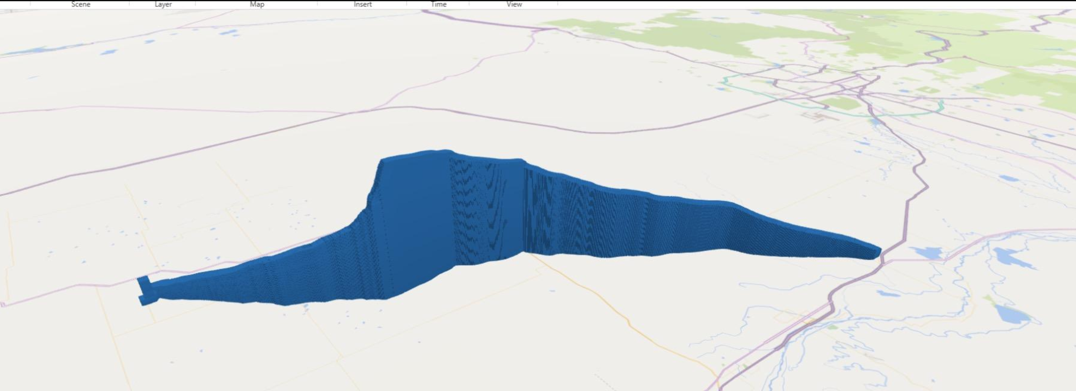
Launch Day
Payload traveled over 110 miles east and gained an elevation of approximately 100,000 ft
With time traveled, troubleshooting, and communication, the team spent over 11 hours during the launch day for the testing of the system
When the system landed the team was able to get a signal and download some of the relevant data according to the logger protocol developed by Justin and Lucas

Slide 13


Stretch Goals
Roadrunners in space!
AES department students in association with AIAA will be recruiting from the CS 4360 course for their software development needs
York Space Systems: Resources for satellite tracking and mission planning
NCAR: Mission planning for space weather data collection
AFWERX: Potential missions with the DoD and new USSF directives
With a 16-week timeline our team did not meet our stretch goal of deploying a CubeSat; however, we have successfully laid the groundwork that can be expanded upon

Slide 14
Summary
Met our minimum viable product of a launched payload and data retrieval
Did not meet the stretch goal, but other organizations in MSU Denver are positioned to continue to develop and meet the CubeSat mission
Financial constraints were the primary blocker, although with purely off-the-shelf components the team was still able to prototype a payload that could feasibly operate in a low earth orbit

